Slide 1

HOSPITAL MANAGEMENT SYSTEM
Database Management System
Guided By:
Mrs. Indrakka Mali Mam

Slide 2
INTRODUCTION
The project “Hospital Management System” is developed using spring boot framework, which mainly focuses on basic operations. Like Inserting, Deleting, Updating and getting all records of Doctor and Patient information.
It is accessible by Receptionist. Only they can add and delete the data into the database. The data can be retrieved easily. The data are well protected for personal use and make the data processing very fast.
The project Hospital Management System included the registration of Patient, Storing the details into the system by using the database. The software has the facility to give a unique ID for every Patients and Doctors and stores the details of every patients and staff manually.

Slide 3

Objectives
Provides Better and Efficient Service.
Faster way to get information about the patients.
Provides facility for proper monitoring and less paper work
All details are available on a click.

Slide 4
Need Of HMS
To keep track of hospitals day-to-day activities & records of its patients, doctors that keep the hospital running smoothly & successfully there is need of Hospital Management System.
To digitalize all the version of the manual system.
To provide a paper-less hospital up to 80%, i.e. To provide low-cost reliable digitalization of the existing system.
To digitalize, the process of day-to-day activities like Registering New patient and Assigning a doctor to new patient etc.
To provide excellent security of data at every level of user-system interaction and also to provide robust & reliable storage facility.

Slide 5
Proposed System
The new system is to control the following information:
Patient Information.
Doctor Information.
Appointment Details.
These services to be provided in an efficient, cost effective manner, with the goal of reducing the time and resources currently required for such tasks.

Slide 6

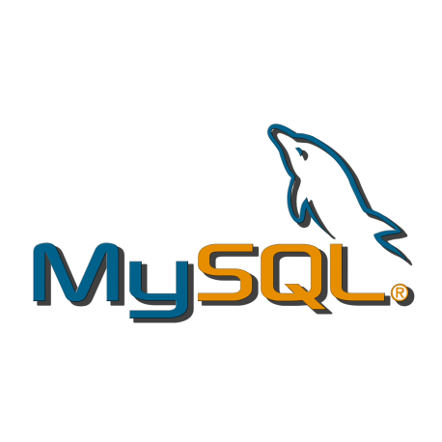
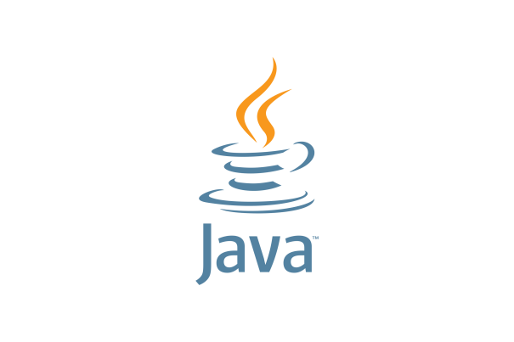



Technologies Used
HIBERNATE
TOMCAT SERVER
POSTMAN

Slide 7

Modules in
HMS
DOCTOR MODULE
PATIENT MODULE
3. RECEPTIONIST MODULE

Slide 8
HMS Project Structure

Slide 9
Database Structure

Slide 10

Features of Doctor Module
Add Doctor
View Doctor by ID
DOCTOR
Update Doctor
Delete Doctor
View Patients

Slide 11

Features of Patient Module
PATIENT
View Their Details using their ID

Slide 12

Features of Receptionist Module
Add Patient
View Patient
Receptionist
Update Patient
Delete Patient

Slide 13
Postman Operations
GET : Obtain information
POST : Add information
PUT : Update certain information
DELETE : Delete information

Slide 14
Annotations
@Springbootapplication
It is used to mark a configuration class that declares one or more @Bean methods and also triggers auto-configuration and component scanning.
@Entity
It specifies that the class is an entity and is mapped to a database table.
@RestController
It is a convenience annotation for creating Restful controllers. It is a specialization of @Component and is auto detected through class path scanning. It adds the @Controller and @ResponseBody annotations. It converts the response to JSON.
@Service
We mark beans with @Service to indicate that they're holding the business logic. Besides being used in the service layer, there isn't any other special use for this annotation.
@Repository
It job is to catch persistence-specific exceptions and re-throw them as one of spring’s unified unchecked exceptions.

Slide 15
Annotations
@Id
It is specifies the primary key of the object's table.
@Autowired
It is used for dependency injection. In spring boot application, all loaded beans are eligible for auto wiring to another bean.
@OneToMany
A one-to-many relationship between two entities is defined by using the @OneToMany annotation in Spring Data JPA. It declares the mappedBy element to indicate the entity that owns the bidirectional relationship. Usually, the child entity is one that owns the relationship and the parent entity contains the @OneToMany annotation.
@JoinColumn
It is used to specify a column for joining an entity association or element collection. This annotation indicates that the enclosing entity is the owner of the relationship and the corresponding table has a foreign key column which references to the table of the non-owning side.

Slide 16
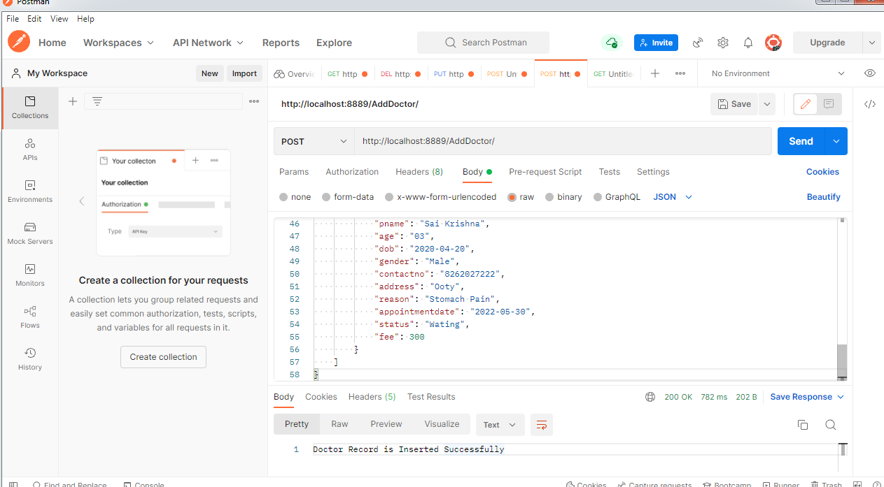
Screenshots
Insert Doctor and patient Record
Url: http://localhost:8089/AddDoctor/

Slide 17
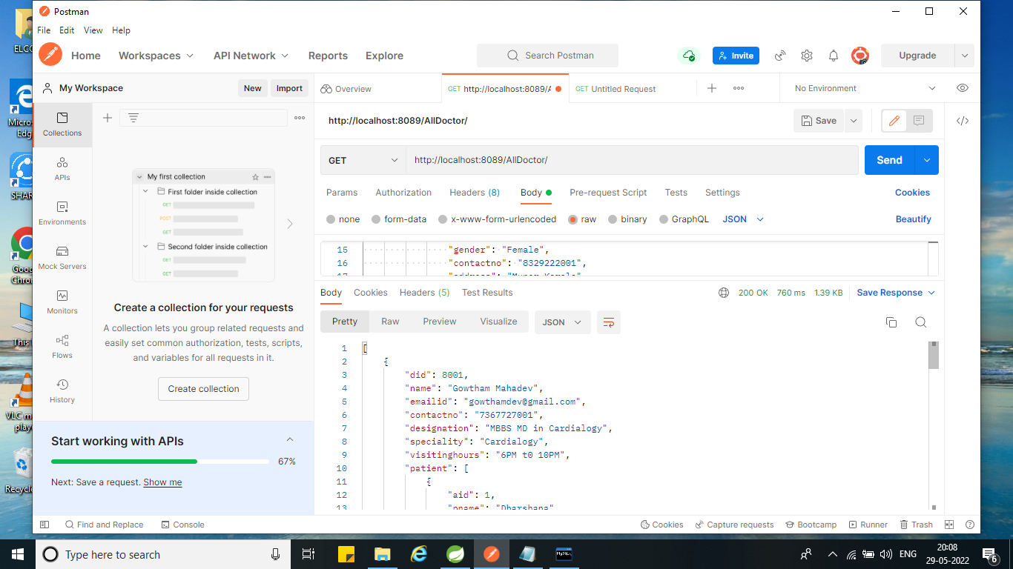
Get all Doctor record
Url: http://localhost:8089/AllDoctor/

Slide 18
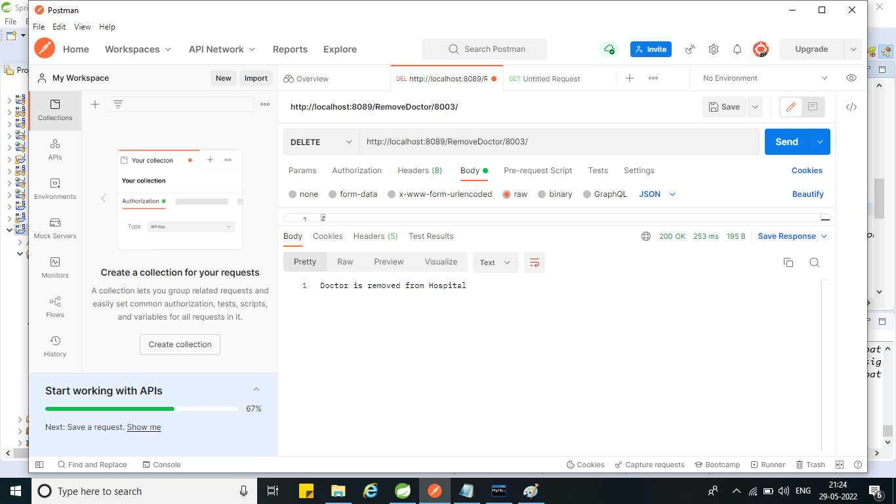
Delete the Doctor Record By Id
Url: http://localhost:8089/RemoveDoctor/8003/

Slide 19
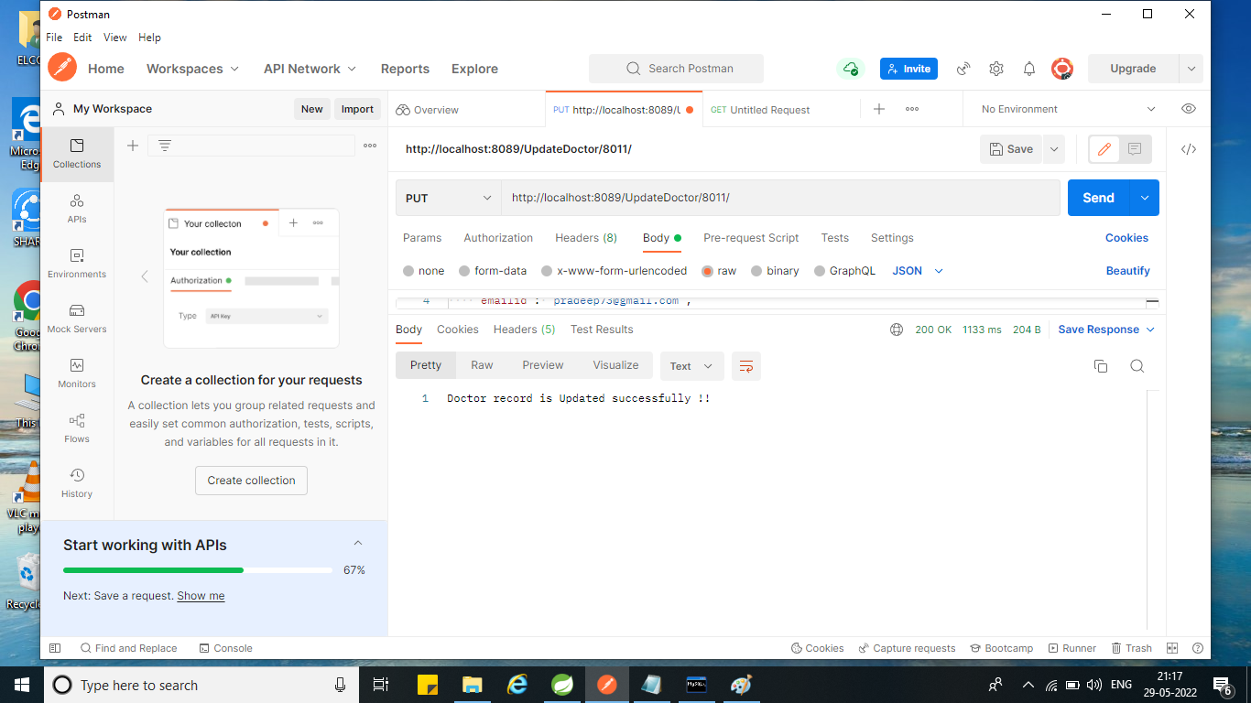
Update the Doctor Record ById
Url: http://localhost:8089/UpdateDoctor/8011/

Slide 20

Update the Patient Record ById
Url: http://localhost:8089/UpdatePatient/1/

Slide 21

If we want to show unavailable patient with their id then it is show exception like “please enter valid data to update the Record”
Url: http://localhost:8089/UpdatePatient/10/

Slide 22
Benefits of HMS
Records makes readable and understandable.
Eliminate redundancy in term of data storage. Data will be stored in a computer not heap of files.
Reduce the time wasted in retrieving data especially in finding a doctor’s personal details and patients past health records.
Increase Efficiency and Interactivity in any area of specialization in the hospital.
Able to quickly collect and edit data, summarize result and adjust as well as collect errors promptly.
For small or medical scale hospitals.

Slide 23

Feature Scope
To include Administration module
To include Login Validation
To Manage Patient IPD Section

Slide 24
Conclusion
Since we are entering details of the patients electronically in the “Hospital Management System”, data will be secured.
It easily reduces the book keeping task and thus reduces the human effort and increases accuracy speed.

Slide 25

Team
Members
Dharani M
Keshava Devi B
Priyadharshini K
Srimugi M
Tharani M

Slide 26
Thank You !

